Slide 1
A multimedia project used by
VLC, Youtube, Vimeo, HandBrake
and many others
Carl Eugen Hoyos

Slide 2
FFmpeg
Fabrice Bellard (QEMU) December 2000
Michael Niedermayer since 2004
>1.000.000 LOC, >1000 contributors
~200 contributors, 3000 commits per year
LGPL (optional parts: GPL and proprietary)
Source code, no “products”

Slide 3
Command line utilities
ffmpeg
ffplay
ffprobe
qt-faststart

Slide 4
Libraries
libavformat
libavcodec
libavfilter
libswscale
libswresample
libavdevice
libpostproc
libavutil

Slide 5
libavformat 1/2
mov/mp4/isom (Apple QuickTime)
avi (Microsoft)
asf/wma/wmv (Microsoft)
Matroska/WebM
MPEG-TS (DVB) , MPEG-PS (DVD)
ogg (Xiph)

Slide 6
libavformat 2/2
MXF
HLS / DASH (streaming)
wav (Microsoft audio)
caf (Apple audio)
flv (Macromedia / Adobe)
nut (FFmpeg)

Slide 7
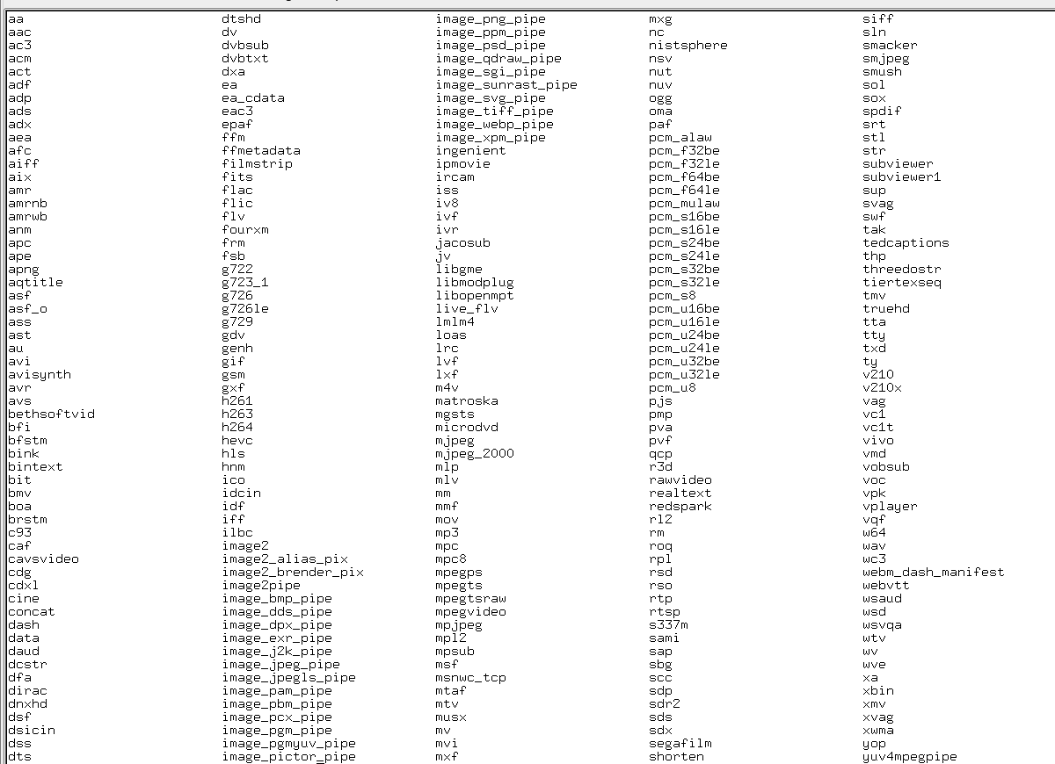

Slide 8
libavcodec video 1/2
MPEG Video / H.261 (Encoding & Decoding)
MPEG-4 ASP / H.263 (Encoding & Decoding)
MPEG-4 AVC / H.264
HEVC
VC-1 (Microsoft)
Theora

Slide 9
libavcodec video 2/2
Duck TrueMotion 1.0, 2.0, VP3, VP4, VP5, VP6, VP7, VP8, VP9 (Google)
Sorenson Video 1, 3, Spark (Apple, Flash)
RV10, RV20, RV30, RV40 (RealVideo)
huffyuv, ffvhuff, Lagarith (lossless)
DnxHD, ProRes, CineForm (Intermediate)
FFv1, Snow (FFmpeg)

Slide 10
AV1
Internal parser
Two external decoding libraries
Two external encoding libraries
no internal decoder (yet?)

Slide 11
libavcodec audio
MP1, MP2, MP3
AC-3, E-AC-3, TrueHD (Dolby)
AAC
DTS, …, DTS HD-Master
Vorbis, Opus
Sonic (FFmpeg)

Slide 12
libavcodec image formats
jpg / lossless jpeg / jpeg lossless
bmp
png
SGI
TIFF
DPX
JPEG-2000

Slide 13
libavfilter
Scale, Crop
Overlay
Hue
De-interlacers, Inverse telecine filters
Framerate interpolation filters
> 250 Filters

Slide 14
Obsolescence (media formats)
WMV
Duck Truemotion (Sega Saturn)
4xm (Gameboy, Sega, Windows)
Sega Film
SNM (LucasArts)
THP (Nintendo)

Slide 15
Obsolescence (FFmpeg)
ANSI C, Posix

Slide 16
NIH
The Ten commandments for C programmers:
7) Thou shalt study thy libraries and strive not to reinvent them without cause, that thy code may be short and readable and thy days pleasant and productive.
FFmpeg:
Our wheels are rounder

Slide 17
Bugs
FLAC: 2006 – 2015
Possibly relevant for Archivists
Produced non-lossless files
Recoverable
Reproducible only with FFmpeg, not Xiph's libflac

Slide 18
What’s new
8-channel E-AC-3 decoding (Paul B Mahol)
Many new filters (Paul B Mahol)
Bit-exact vc1 decoding (Jerome Borsboom)
HLS and DASH improvements
Improved hardware decoding and encoding for Nvidia, AMD and Intel

Slide 19
What’s missing
Removal of an external filter because of license violations

Slide 20
What is FFmpeg not
FFmpeg is not a file archiving system
FFmpeg is not a file validator
FFmpeg is not bug-free
FFmpeg is not feature-complete

